Slide 1
polyalphabetic Substitution Cipher- Task 2
Aniket Dere
Matriculation Number: 60334138

Slide 2
Introduction
A polyalphabetic cipher is a type of substitution cipher in which the cipher alphabet is changed periodically while enciphering the plaintext. This method of encryption provides a significant improvement in cryptographic security over simple monoalphabetic ciphers, where only one fixed alphabet substitution is used throughout the entire encryption process.

Slide 3
Methodology
The process begins with Alice sharing an encrypted text, which is then stored in a database in encrypted format. Oscar retrieves this encrypted text from the database for decryption using poly alphabetic cipher.

Slide 4
Conclusion
This report presents a method for decrypting texts encrypted using the PolyAlphabetic Substitution Cipher with original key being sent to in secured manner.

Slide 5
Appendices
Alice will share enter the text which need to transfer to bob via encrypted message so:
I am taking user input so that alice can enter text.
“encryptedbob” key is transfer to BOB in secure manner so that he can use it to read the message.
As shown in above fig.1 Oscar will get the encrypted text from Database.
However BOB get the key in secure manner and he decrypt the message.

Slide 6
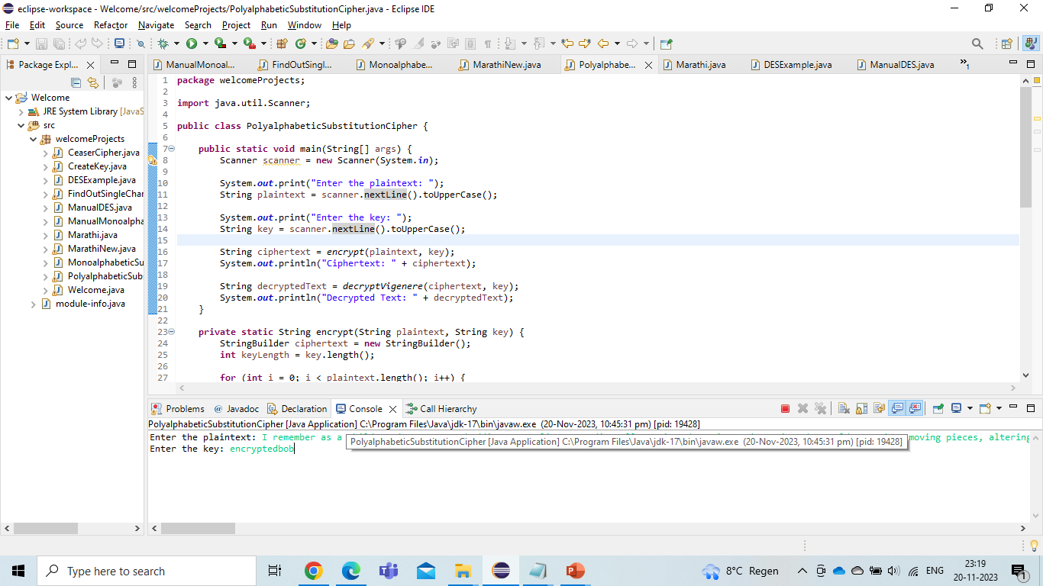

Slide 7
encrypt(String plaintext, String key)
This method will if char present in Paragraph is letter or not.
If letter is character then below operation is performed.
((plainChar + keyChar - 2 * 'A') % 26 + ‘A’)
With this operation character will be encrypted and appended into string
Refer below SS for below code snipet.

Slide 8
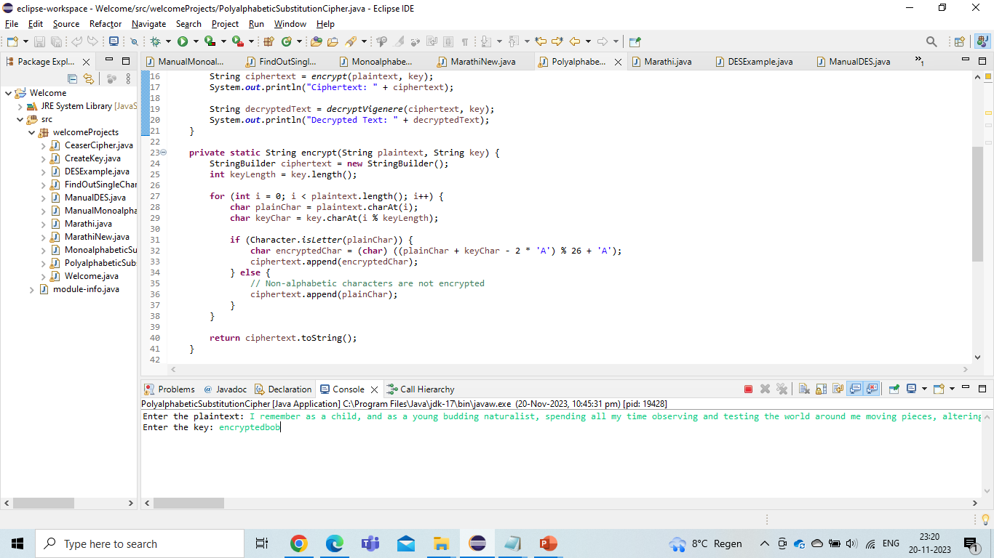

Slide 9
decryptVigenere(String ciphertext, String key)
In order to decrypt any ciphered text, same logic as encryption is used.
Ciphered text is check if Char is letter or not and below operation is performed.
((encryptedChar - keyChar + 26) % 26 + ‘A’
Output of operation will be appended in String as decrypted charaters. Ref below Img.

Slide 10
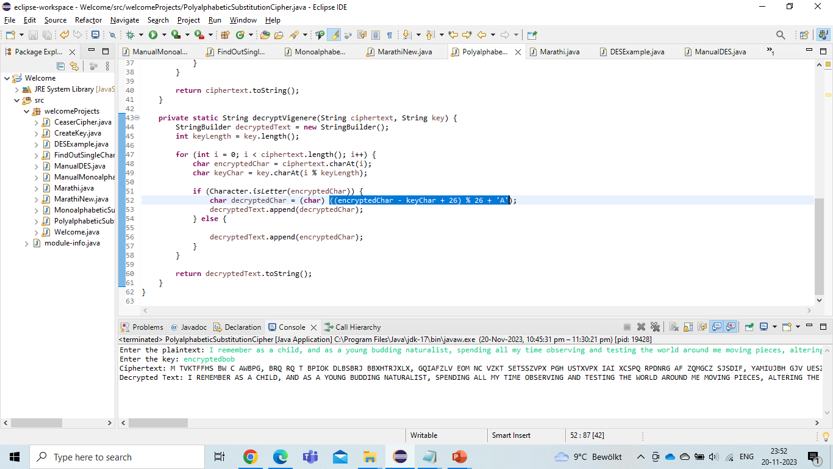

Slide 11
Breaking of poly alphabetic cipher
Poly alphabetic breaking cipher can take time depend length of the key.
Key is consist of 12 letters therefore with brute force attack it will take 26 ^12 attempts to crack the key.
Kasiski Examination: This method involves looking for repeating patterns in the ciphertext to guess the length of the key. Once the key length is known, the cipher can be treated as multiple interwoven Caesar ciphers, which can be solved individually.

